Slide 1
Accumulator machine
We will use the accumulator machine architecture to demonstrate pass1 and pass2.
The accumulator machine
has one processor register: the accumulator
all other operands are in memory, and expressions require a sequence of load/operate/store instructions.

Slide 2
accumulator machine instruction set
opcode address operation name machine action
halt ---- halt stop execution
div addr divide acc = acc/memory[addr]
mul addr multiply acc = acc*memory[addr]
sub addr subtract acc = acc-memory[addr]
add addr add acc = acc+memory[addr]
load addr load acc = memory[addr]
store addr store memory[addr] = acc
ba addr branch always pc = addr
blt0 addr branch on less than if acc<0 then pc = addr
ble0 addr branch on less than or equal if acc<=0 then pc = addr
beq0 addr branch on equal if acc==0 then pc = addr
bne0 addr branch on not equal if acc/=0 then pc = addr
bge0 addr branch on greater than or equal if acc>=0 then pc = addr
bgt0 addr branch on greater than if acc>0 then pc = addr
print addr print display contents of memory[addr]

Slide 3
assembly language pseudo-ops
name arg1 arg2 meaning
comment text allows for comments within program
end symbol defines starting address of program (should
appear once, as the last line of the program)
label symbol defines a symbolic address within the program
word symbol value defines a symbol address and allocates a data
word at that address with the given value

Slide 4
Accumulator machine program - example 1
comment(` first example accumulator machine program ')
comment(` ')
comment(` data section for program -- word(label,value) ')
word(a, 23)
word(b, 45)
word(c, 17)
word(d, 0)
comment(`code that implements the expression d = a + b - c;')
label(start)
load(a) comment(` ACC <- memory[a] ')
add(b) comment(` ACC <- ACC + memory[b] ')
sub(c) comment(` ACC <- ACC - memory[c] ')
store(d) comment(` memory[d] <- ACC ')
halt
comment(` start execution at label start ')
end(start)

Slide 5
Accumulator machine
executable is in numeric format -- example assembly
(numbers are in decimal rather than binary)
the assembler has a location counter variable called "loc" that it uses in the first pass to assign addresses

Slide 6
accumulator machine
instruction table (built into assembler)
name opcode args loc increment
add 40 $1 2 <- add is defined as two words
sub 30 $1 2 * first word is opcode 40
load 50 $1 2 * second word is address of arg
store 60 $1 2 * loc should be incremented by 2
halt 00 1

Slide 7
accumulator machine
Pass 1
first pass input -- symbol table after first pass
assembly stmts label addr==loc
word(a,23) a 00 <- a is defined as location 00
word(b,45) b 01 <- b is defined as location 01
word(c,17) c 02 <- c is defined as location 02
word(d,0) d 03 <- d is defined as location 03
label(start) start 04 <- start defined as location 04
...
<< no other statements
define labels >>
...

Slide 8
accumulator machine
Pass 2
second pass input "executable" after second pass
(loc:) assembly language addr: machine code or data
(00:) word(a,23) 00: 23 <- value in location a
(01:) word(b,45) 01: 45 <- value in location b
(02:) word(c,17) 02: 17 <- value in location c
(03:) word(d,0) 03: 0 <- value in location d label(start)
(04:) load(b) 04: 50 <- opcode for load
05: 00 <- address of a
(06:) add(c) 06: 40 <- opcode for add
07: 01 <- address of b
(08:) sub(d) 08: 30 <- opcode for sub
09: 02 <- address of c
(10:) store(a) 10: 60 <- opcode for store
11: 03 <- address of d
(12:) halt 12: 00 <- opcode for halt
(13:) end(start) 13: 04 <- starting address

Slide 9
Control structures in assembly language
int x;
int y;
if(x == 0)
y = 1;
/* assume values for x, y, and one */
true (process)
x == 0?
false
(do_nothing)
y = 1
exit
C Source Code | Inefficient Assembly | Efficient Assembly
int x; int y; if(x == 0) y = 1; | load(x) beq0 process ba do_nothing label(process) load(one) store(y) label(do_nothing) . . . | load(x) bne0 do_nothing label(process) load(one) store(y) label(do_nothing) . . .

Slide 10
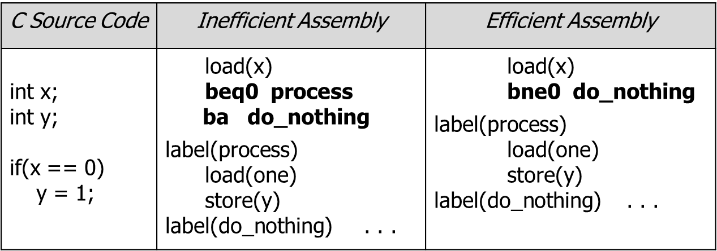
C if statement in ARM
Note that the "Inefficient Assembly" code contains back-to-back branches (beq0 followed by ba). We would like to avoid this, since branches may cause a delay slot.
One way to remove the back-to-back branches is to change the condition for branching, as in the "Efficient Assembly" code.

Slide 11
C if statement in accumulator machine code
if((x+b)>z)
x+=y;
Accumulator machine code:
/* assume x , b, y, z have values*/
load(x)
add(b)
sub(z)
ble0(do_nothing) comment(` branch to do_nothing’)
load(x)
add(y)
store(x)
label(do_nothing)
…
true (process)
x+y > z?
false
(do_nothing)
x += y
exit

Slide 12
C if-else statement in accumulator machine code
if(i == j)
f=g+h;
else
f=g-h;
Accumulator code:
/* assume values for f, i, j, g, and h */
load(i)
sub(j)
beq0(then_part)
label(else_part)
load(g)
sub(h)
ba(done)
label(then_part)
load(g)
add(h) label(done)
store(f)
false (else_part)
true
(then_part)
i == j?
f=g-h
f=g+h
exit

Slide 13
Loops
Implementing Loops
All for loops, while loops, and do-while loops have an implicit branch from the bottom to the top of the loop.
This branch instruction becomes explicit when translated into assembly.
while ( x <= 10 ) . . .
{ load(x)
x = x + y; label(loop)
} sub(ten)
bgt0(done)
load(x)
add(y)
store(x)
ba(loop)
label(done)
test condition;
exit loop if false
body of loop; also updates the lcv

Slide 14
Loops
Alternate implementation:
(eliminates one of the branch instructions in the loop)
while ( x <= 10 ) . . .
{ load(x)
x = x + y; sub(ten)
} bgt0(done)
label(loop)
load(x)
add(y)
store(x)
sub(ten)
ble0(loop)
label(done)
test condition; skip loop if false
body of loop; also updates the lcv
test condition; loop again if true

Slide 15
Loops in C/Assembly (accumulator machine code)
for loop
for ( x = 1; x <= y; x++ ) load(one)
{ store(x)
z *= x; label(loop)
} sub(y)
bgt0(done)
load(z)
rewritten as while loop mul(x)
x = 1; store(z)
while ( x <= y ) load(x)
{ add(one)
z *= x; store(x)
x++; ba(loop)
} label(done)
test condition;
exit loop if false
loop body
update lcv

Slide 16
Loops in C/Assembly (accumulator machine code)
for loop - alternate implementation
(eliminates one of the branches in the loop)
for ( x = 1; x <= y; x++ ) load(one)
{ store(x)
z *= x; sub(y)
} bgt0(done)
label(loop)
load(z)
rewritten as while loop mul(x)
x = 1; store(z)
while ( x <= y ) load(x)
{ add(one)
z *= x; store(x)
x++; ble0(loop)
} label(done)
test condition;
skip loop if false
loop body
update lcv
test condition;
loop again if true

Slide 17
accumulator machine program– example 2
comment(` second example accumulator machine program ‘)
comment(` code that implements the loop ')
comment(` sum = 0; ')
comment(` for( i = 10; i > 0; i-- ){ ')
comment(` sum = sum + i; ')
comment(` } ')
label(begin)
load(zero) comment(` sum = 0 ACC <- memory[zero] ')
store(sum) comment(` memory[sum] <- ACC ')
load(ten) comment(` i = 10 ')
store(i)
label(loop)
load(i) comment(` branch to done if i <= 0 ')
ble0(done)

Slide 18
accumulator machine program– example 2 (cont’d)
load(sum) comment(` sum = sum + i ')
add(i)
store(sum)
load(i) comment(` i = i - 1 ')
sub(one)
store(i)
ba(loop) comment(` unconditionally go back to loop ')
label(done)
halt
comment(` data section for program - can be at bottom ')
word(sum,0)
word(i,0)
word(zero,0)
word(one,1)
word(ten,10)
comment(` start execution at label begin ')
end(begin)

Slide 19
Graphical simulator for the accumulator machine
CPU | PC IR ACC |  |  | Memory
BIU | MAR ---- MDR ---- | address lines -- data lines ------
 | ---- | control lines ---

Slide 20
Graphical simulator for the accumulator machine
CPU
PC (program counter) - points to next instruction
IR (instruction register) - holds current instruction
BIU (bus interface unit)
MAR (memory address register) – a CPU register that either stores the memory address from which data will be fetched to the CPU or the address to which data will be sent and stored
MDR (memory data register – a CPU register that contains the data to be stored in memory or the data after a fetch from memory.

Slide 21
Graphical simulator for the accumulator machine
copy the files into your directory as instructed in the lab
run the shell script “./assemble.sh" (which input from the specified file and produces numeric output in the file "executable")
run simulator “./acc" (reads program in numeric form from "executable")
you can click on "RT advance" to see the effect of one register transfer or "Instruction Advance" to see the effect of one instruction
"RT Run" will run the program, RT-step by RT-step (you control the interval between step by using the slider labeled "RT Run interval")
"Stop" stops the RT-run mode
"Reset" reloads the program from the file named" executable"
"Quit" exits the simulator

